Slide 1
ISMB Collaboration Fest 2025
Enhancing Protein Knowledge Curation using Gene Ontology Annotations and Large Language Models for Community Literature Submissions
Yvonne C. Lussi
PhD, Senior Scientific Database Curator, UniProt, EMBL-EBI
23 July 2025

Slide 2
Extract experimental data from community submissions
Info here: ISMB CollaborationFest 2025 - Open Bioinformatics Foundation
Github repository for Gene Ontology Annotations exercise:
https://github.com/anphan0828/ISMB_CollaborationFest_EBI
Objective: Extract experimental evidence from scientific literature for proteins:
GO annotation manually or with LLMs
UniProt line-type style annotation extraction from literature
Text-style summaries of literature
The dataset can be found here
Results: Spreadsheet or word file here: Results_CollaborationFest_GOA

Slide 3
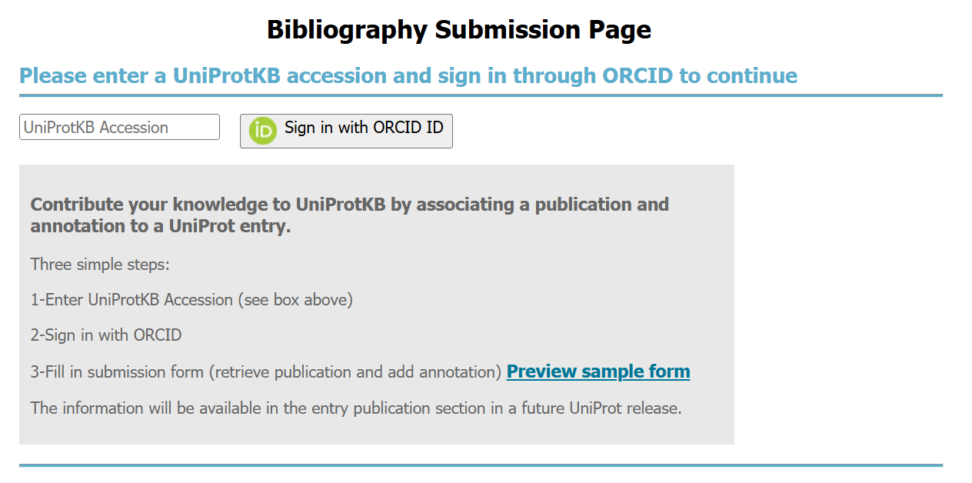
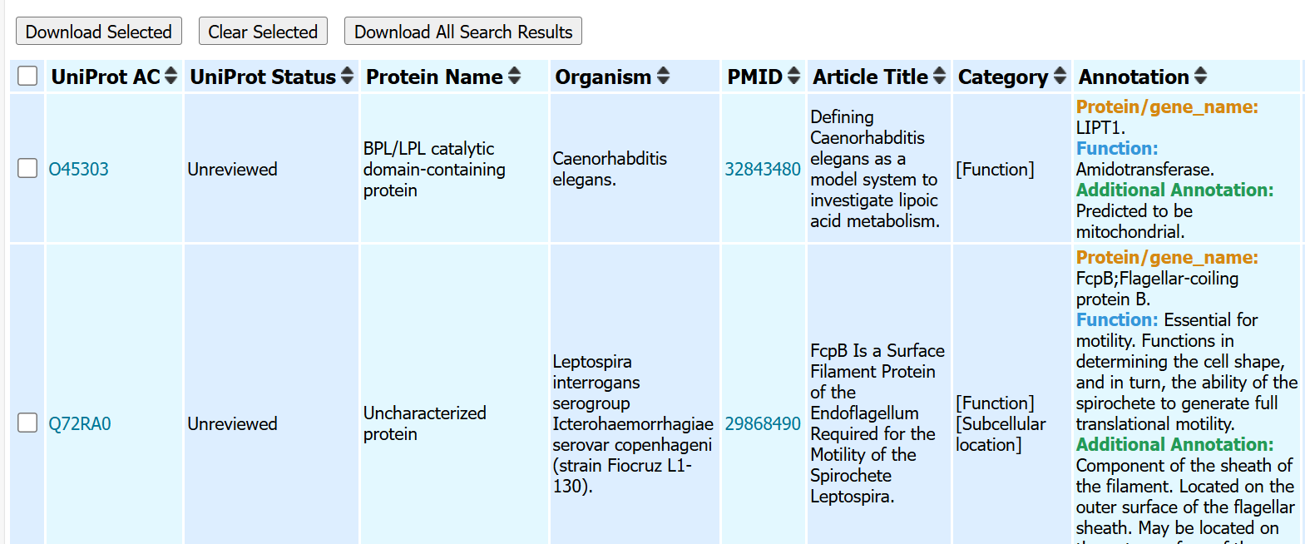
Community Submissions to UniProt
Submitted by UniProt community
Publications not yet curated in UniProt

Slide 4
Why using Gene Ontology (GO)
The world’s largest resource on gene functions (http://geneontology.org/)
Built for a specific purpose
Aims to capture biological knowledge and to describe attributes of gene products:
In a species agnostic manner
In language interpretable by humans and machines (ontologies)
Provide a resource for analysis of large-scale datasets
Freely available

Slide 5
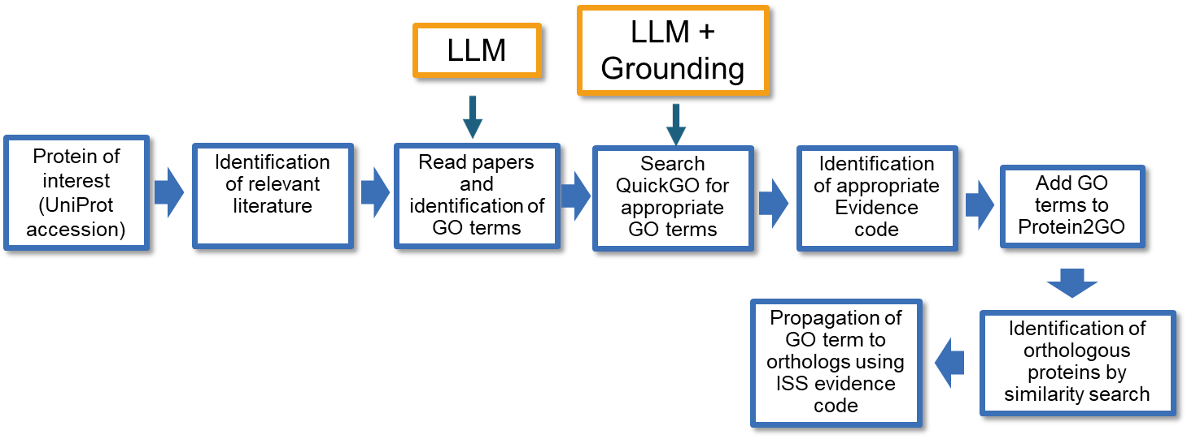
GO annotation workflow: support by LLMs

Slide 6
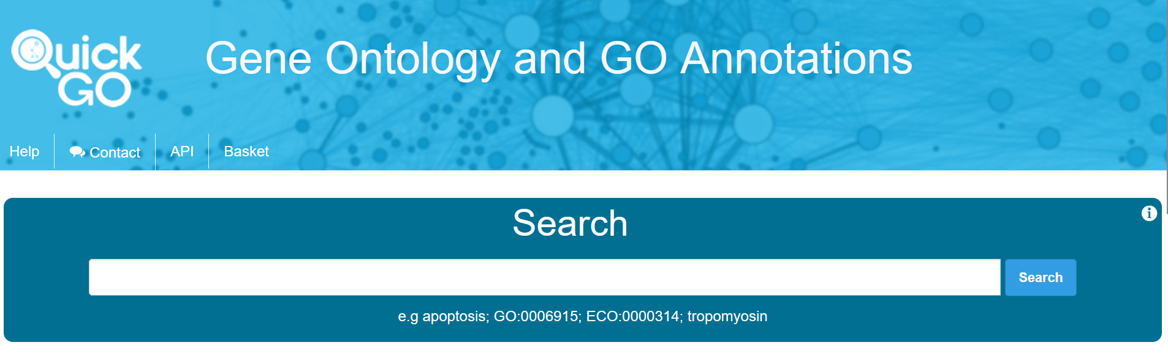
Finding and selecting terms in QuickGO
Ontology browsers (e.g. QuickGO, AmiGO) enable term browsing
Look at existing annotations, including orthologs or related genes – what have other curators annotated to
https://www.ebi.ac.uk/QuickGO/

Slide 7
Resources
GO website documentation
https://geneontology.org/search.html
Introduction to GO annotations https://geneontology.org/docs/go-annotations/
Annotation guidelines (primarily aimed at curators)
https://wiki.geneontology.org/Annotation_guidelines
Specific curation guides E.g.
Transcription factors https://docs.google.com/document/d/1bqCxx7QUblrc9q4PIynbJzoCXv248UWBxJa7fguJyXs/edit#heading=h.pwxacfdlynjn
Chromatin remodeling https://docs.google.com/presentation/d/15fDBhmO54zSJms25aV5nX3kgSwsHMnWgdSuPdo-ukyw/edit#slide=id.gf4888089cb_0_59
Signaling https://docs.google.com/document/d/1ukxL3vKfLbV4NAiGSeGg3EbpLKijfXXOr0npHeUYLI4/edit#heading=h.9ixhtvdrf3ju
Evidence codes: https://geneontology.org/docs/guide-go-evidence-codes/
Github:
Onboarding: https://wiki.geneontology.org/New_member_onboarding#Checklist_for_all_Gene_Ontology_Consortium_Members_and_Contributors
Ontology: https://github.com/geneontology/go-ontology/issues
Annotation: https://github.com/geneontology/go-annotation/issues

